Slide 1
Transport Layer Security
Secure Socket Layer

Slide 2
What is SSL and why is it important?
SSL is standard technology for securing an internet connection by encrypting data sent between a website and a browser (or between two servers).
Secure Sockets Layer (SSL) certificates, sometimes called digital certificates.
It is used to establish an encrypted connection between a browser or user’s computer and a server or website.
It prevents hackers from seeing or stealing any information transferred, including personal or financial data.

Slide 3
WHAT ARE TLS/SSL CERTIFICATES?
Transport Layer Security (TLS) certificates are most commonly known as SSL, or digital certificates.
They are the foundation of a safe and secure internet. TLS/SSL certificates secure internet connections by encrypting data sent between your browser, the website you’re visiting, and the website server.
They ensure that data is transmitted privately and without modifications, loss or theft

Slide 4
WHY DO SITES NEED TO USE TLS/SSL CERTIFICATES?
TLS/SSL certificates are the standard by all major web browsers to ensure a safer internet experience for users.
Websites secured by TLS/SSL certificates are more trusted by internet users because they encrypt and protect private information transferred to and from their website.
They also represent, or certify, your website’s brand identity.
So, TLS/SSL certificates are both an identity protection measure for online brands, and a security measure for companies transmitting private data online.

Slide 5
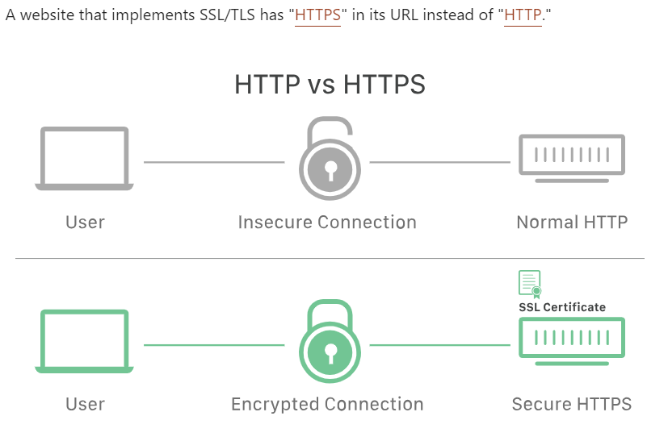

Slide 6
How does SSL/TLS work?
To, provide a high degree of privacy, SSL encrypts data that is transmitted across the web. This means that anyone who tries to intercept this data will only see a garbled mix of characters that is nearly impossible to decrypt.
SSL initiates an authentication process called a handshake between two communicating devices to ensure that both devices are really who they claim to be.
SSL also digitally signs data to provide data integrity, verifying that the data is not tampered with before reaching its intended recipient.

Slide 7
Why is SSL/TLS important?
Originally, data on the Web was transmitted in plaintext that anyone could read if they intercepted the message. For example, if a consumer visited a shopping website, placed an order, and entered their credit card number on the website, that credit card number would travel across the Internet unconcealed.
SSL was created to correct this problem and protect user privacy. By encrypting any data that goes between a user and a web server, SSL ensures that anyone who intercepts the data can only see a scrambled mess of characters. The consumer's credit card number is now safe, only visible to the shopping website where they entered it.
SSL also stops certain kinds of cyber attacks: It authenticates web servers, which is important because attackers will often try to set up fake websites to trick users and steal data. It also prevents attackers from tampering with data in transit, like a tamper-proof seal on a medicine container.

Slide 8
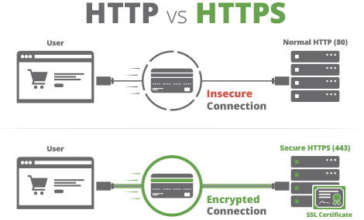
Secure Socket Layer
A Secure Socket Layer (SSL) is a security protocol developed by Netscape in the 1990’s for sending information securely (encrypted) over the Internet.
Once upon a time, websites used SSL only for secure areas of their websites, such as user login pages or online checkout. Today, SSL has been deprecated (replaced) by a new standard for online encryption of website traffic known as Transport Layer Encryption.
Websites used SSL and now TLS to encrypt all data in motion between the web browser and destination website. This prevents hackers from intercepting and reading the transmissions.
You will know you’re protected by SSL or TLS whenever you visit a website and your browser URL Bar displays a Lock symbol.
SSL and TLS accomplish their encryption by use of special digital certificates which tie back to the identity and owner of the company or merchant in question. This allows online shoppers to trust that the website is secure and reliable.
If you host a website, make sure you purchase a SSL/TLS Certificate from a trusted Certificate issuer.

Slide 9
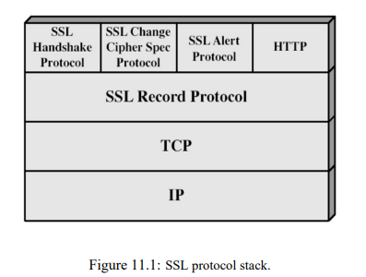
SSL protocol stack

Slide 10
The SSL record protocol, which is at a lower layer and offers services to these three higher level protocols.
1. Handshake Protocol.
2. Change Cipher Spec Protocol.
3. Alert Protocol.

Slide 11
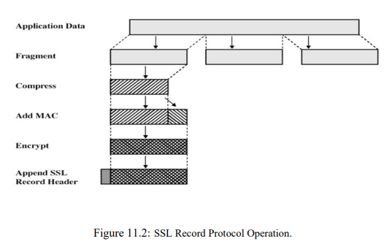
SSL Record Protocol
This protocol provides two services for SSL connections:
Confidentiality - using conventional encryption.
Message Integrity - using a Message Authentication Code (MAC).

Slide 12
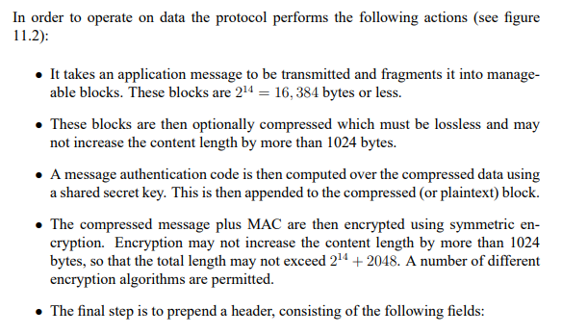

Slide 13
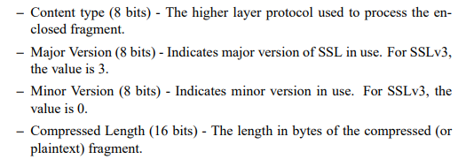

Slide 14
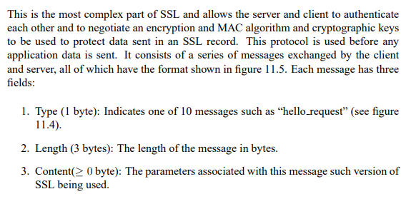
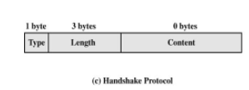
SSL Handshake Protocol

Slide 15
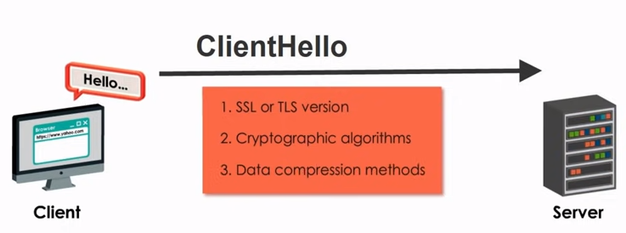
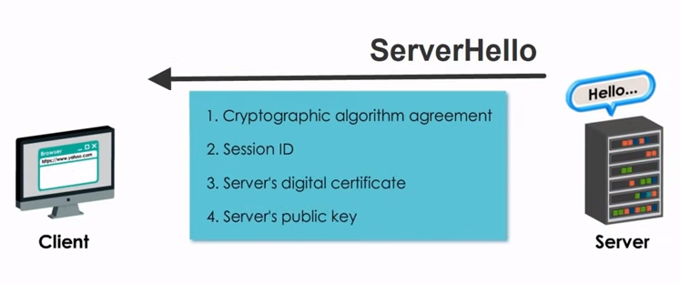

Slide 16
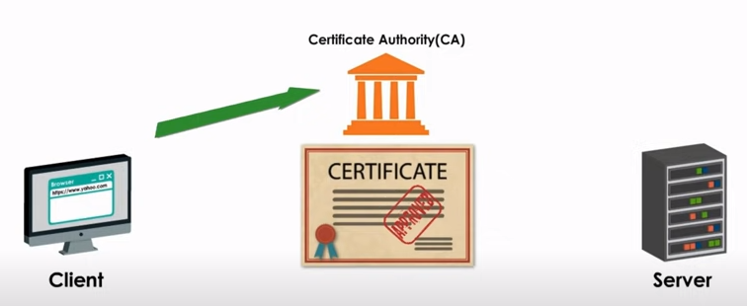
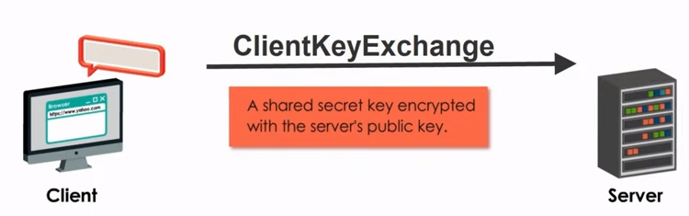

Slide 17
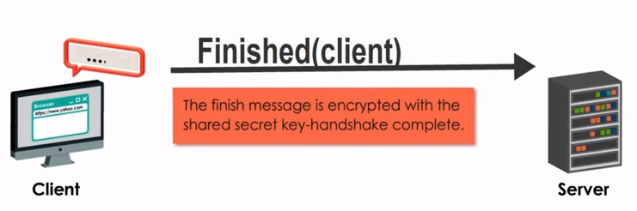
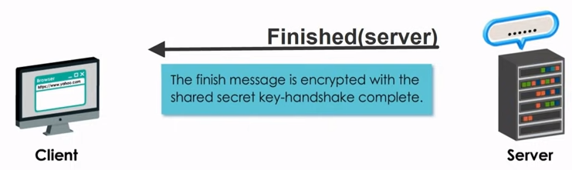

Slide 18
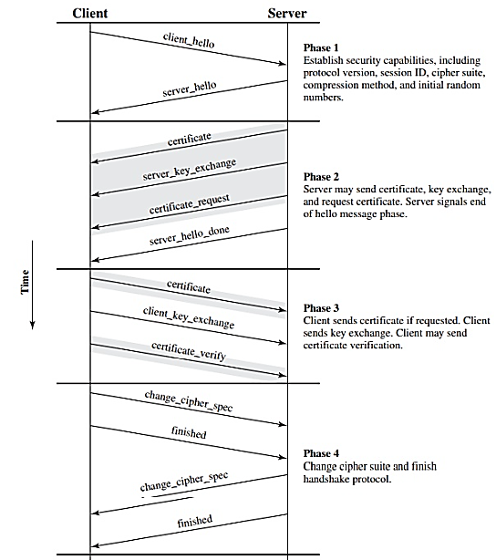

Slide 19
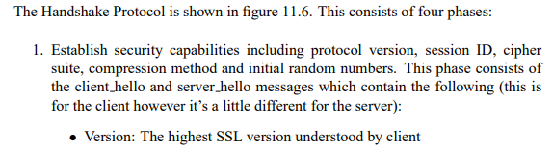
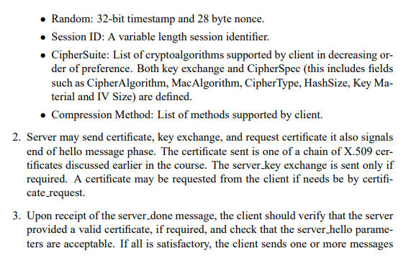

Slide 20
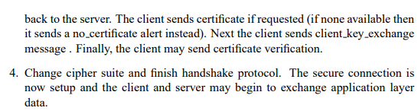

Slide 21
Change Cipher Spec Protocol.
A cipher suite is a set of cryptographic algorithms.
The SSL handshake protocol determines how the client and server negotiate which cipher suites they will use.
The most commonly used cipher suites are:
DES (Data Encryption Standard)
DSA (Digital Signature Algorithm)
KEA (Key Exchange Algorithm)
MD5
RC2
RC4
RSA
SHA-1 (Secure Hash Algorithm)
SKIPJACK
Triple DES

Slide 22
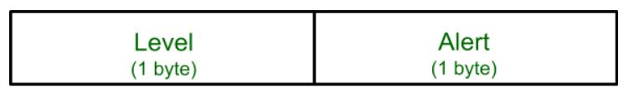
SSL Alert Protocol
This protocol is used to convey SSL-related alerts to the peer entity. Each message in this protocol contains 2 bytes.
Warning (level = 1): This Alert has no impact on the connection between sender and receiver
Fatal Error (level = 2):
This Alert breaks the connection between sender and receiver. The connection will be stopped, cannot be resumed but can be restarted.

